Slide 1
PPDs in Fragile and Conflict-Affected States
IFC Staff Experience
7th PPD Global Workshop
Steve Utterwulghe, Global PPD Lead, WBG

Slide 2
Survey – IFC PPD Experience in FCS
Background: experience shows that PPD plays a special role in FCS
  Institution development
  Transparency
  Trust building
  Peace support
Purpose of survey: collect lessons learned and best practices from existing PPD projects in FCS
Output: a study and toolkit for task team leaders and other staff working on PPD projects

Slide 3
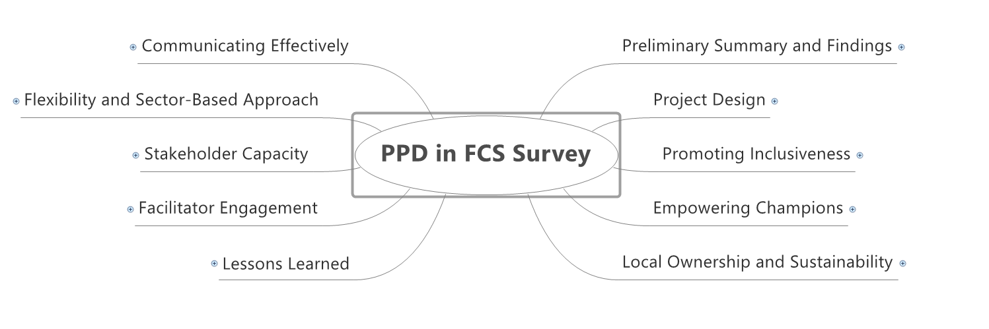
Survey Topics

Slide 4
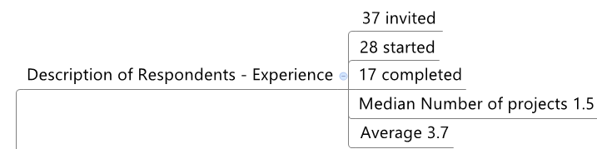
Preliminary Findings – Description of Respondents

Slide 5
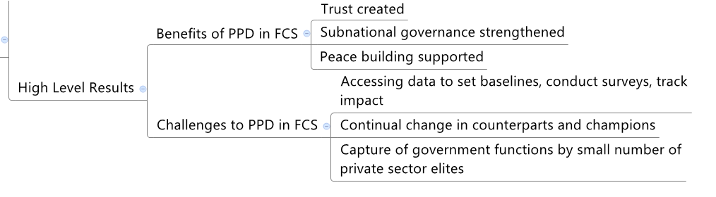
Preliminary Findings – High Level Results

Slide 6
Challenges to Achieving PPD Objectives
Notes:
70% - Weak Gov Institutions Very Important Barrier
Frequently changing public sector counterparts
Public-Private mistrust
Private sector capture of government functions
Lack of capacity to collect evidence or communicate with stakeholders.

Slide 7



Benefits of PPD in FCS
“Built strong, local representation” – South Sudan Investment Climate Reform Program
“Diverse people come together and start to discuss common challenges.” – Afghanistan Private Sector Advocacy Forum
“Improved business confidence …needed for peace to take hold” – Cambodia Government-Private Sector Forum
Notes:
Survey respondents indicated important benefits of PPD in FCS beyond reform and economic improvement. PPD in FCS builds trust that leads to improved local government, such as in South Sudan, brings people together over common challenges that were very recently pushed apart by conflict, and contributes to peace building. In other countries, trusting relationships are created that form the basis for future collaborative problem solving.

Slide 8
Building a Culture of Transparency
Notes:
For many in FCS government or private sector, it a first experience working in a transparent process. In FCS countries, PPD platforms must accommodate transparency in difficult circumstances. For instance, in Liberia, poor infrastructure prevents many stakeholders from traveling to Monrovia to attend events, so our platform puts on a reform road show. We travel around the country with government officials and private sector representatives to hold town-hall like discussions on business registration and tax reform, and to report on the progress that we are making.

Slide 9
Who Participates
Notes:
Question was “On a scale from 1 to 5, with 1 meaning not at all engaged and 5 meaning very engaged, to what extent were the following stakeholder groups engaged in the PPD platform?”
You could make the point that in FCS, ensuring engagement by more than national government and private sector is important.

Slide 10
Possible Areas of Future Work
Greater focus on political-economy analysis
Broad-based stakeholder mapping
Improving data access and collection – baseline, monitoring, impact
Capturing intangible results
Scenario building
Sub-national intervention
Building in adaptive management
Etc.
Notes:
Just some ideas. Let me know if you’d like elaboration on any

Slide 11
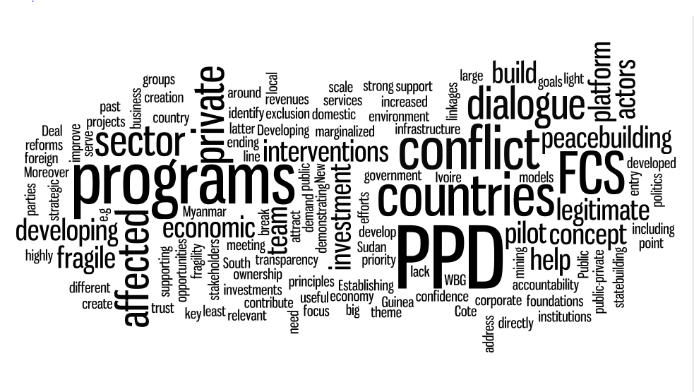
Thank you

