Slide 1

Basics of M&E:
PPD M&E Tools
Malcolm Toland
1

Slide 2
Impact?
2

Slide 3
Tool - PPD Scorecard
3

Slide 4
Output Performance: PPD Performance Scorecard
Tracks outputs for both a specific period of time (every 6 months) as well as since inception.
Period | Outputs
 | # of WG meetings held | # of plenary meetings held | # of reforms proposed in all WGs | # of reforms recommended for enactment by Government | # of reforms enacted | # of reforms implemented
Current 6 months | 10 | 2 | 20 | 12 | 7 | 5
Current 6 months |  |  |  | 60% | 58% | 71%
Previous 6 months | 8 | 2 | 16 | 12 | 9 | 5
Previous 6 months |  |  |  | 75% | 75% | 55%

Slide 5
PPD Scorecard – What it Assesses
Overall level of PPD activity including at WG level and in plenary
Quality of proposals developed
Effectiveness of dialogue at Working Group level; issue selection and filtering process
Effectiveness of a PPD’s advocacy/relationship with Government
5

Slide 6
Tool - PPD Logical Framework
6

Slide 7
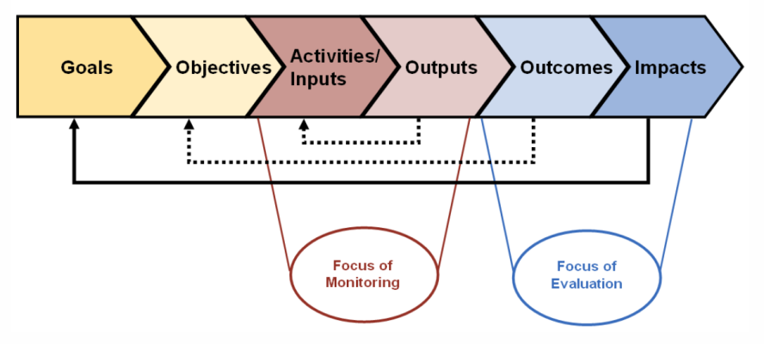
Chain of events
7

Slide 8
Tracking Improvement Over Time – PPD Logical Framework
The PPD Logical Framework incorporates all of the above contents into a single set of indicators to monitor the performance (and improvement) of the PPD over time.
It assesses two factors: (1) how well the PPD is working; and (2) what the PPD is doing or delivering.
8

Slide 9
Level of indicators | Examples
Inputs/ Activities | Human & financial resources Material resources Training
Outputs | Products Recommendations/Plans, Studies/Reports Legislation drafted Press releases
Outcomes | Change in knowledge and/or behavior Improved practices Increased services (access to finance, 1-stop shop) Legislation passed Reduction in # of steps, time and cost in a regulatory process (licensing)
Impact | Increased sales, employment, investment, profitability, income, formalization % increase in government revenue

Slide 10
Tool - PPD Evaluation Wheel
10

Slide 11
Evaluation Wheel – organisational effectiveness
Score measures how well Secretariat is performing tasks along
12 key PPD processes:
Assessing the optimal mandate and relationship with existing institutions
Deciding who should participate and under what structure
Identifying the right champions and helping them to push for reform
Engaging the right facilitator
Choosing and reaching target outputs
Devising a communication and outreach strategy
Elaborating a monitoring and evaluation framework
Considering the potential for dialogue on a sub-national level
Making sector-specific dialogue work
Identifying PPD’s relevance to FDI
Using the dialogue mechanism to address post-conflict/disaster issues and mitigate/manage crisis
Finding the best role for development partners
11

Slide 12
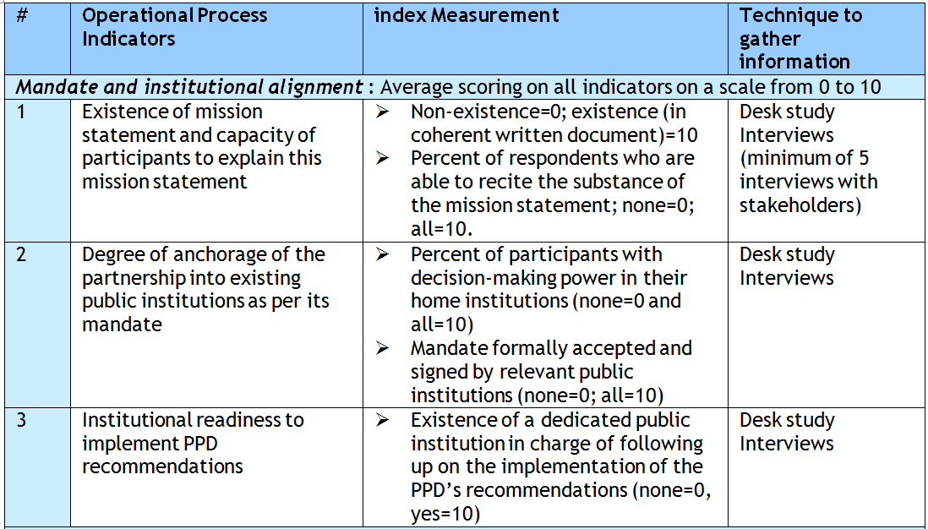
1. Organizational Effectiveness: Evaluation Wheel
Score measures how well the Secretariat is performing tasks along 12 key PPD processes:
Assessing the optimal mandate and relationship with existing institutions
12

Slide 13
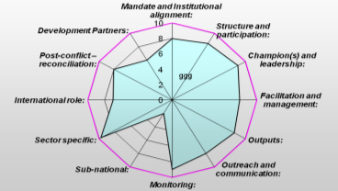
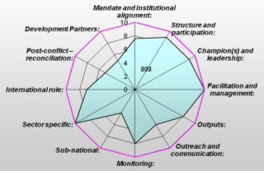
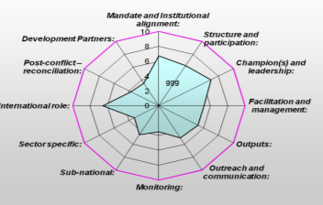
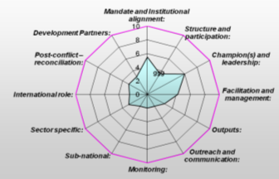
Evaluation Wheel Examples 2008
Vietnam
SPI Albania
Sierra Leone
South Sudan
13

Slide 14
PPD Liberia - Evaluation Wheel at 3 moments
Indicator Nov 2009 March 2011 Nov 2012
Mandate and institutional alignment 8.00 8.83 8.00
Structure and participation 6.25 7.50 8.00
Champion(s) and leadership 7.50 8.50 8.00
Facilitation and management 5.50 7.08 8.04
Outputs 7.39 6.78 6.78
Outreach and communication 7.75 6.83 6.50
Monitoring and evaluation 4.50 4.88 5.50
Sub-national 5.00 5.50 4.25
Sector specific 5.00 3.50 4.25
Relevance to FDI 7.00 7.50 6.00
Post-conflict/disaster/crisis 7.25 7.25 7.25
Development partners 3.00 6.67 6.67
Average Score 6.11 6.73 6.60
14

Slide 15
Benchmarking 2009
# | Country | Total Score | # | Country | Total Score
1 | Cambodia | 94.50 | 14 | Chad | 58.50
2 | Vietnam | 91.75 | 15 | Tonga | 58.25
3 | SPI Romania | 89.25 | 16 | Vanuatu | 57.75
4 | Laos | 88.75 | 17 | Aceh | 55.50
5 | SPI Albania | 88.63 | 18 | Timor Leste | 50.25
6 | Uganda | 81.25 | 19 | South Sudan | 39.50
7 | Liberia | 78.00 | 20 | CAR | 38.75
8 | Bangladesh | 75.00 | 21 | North Sudan | 37.75
9 | Ghana | 72.00 | 22 | Nepal | 37.25
10 | Pakistan | 65.50 | 23 | Cameroun | 34.75
11 | Zambia | 64.75 | 24 | Ethiopia | 31.25
12 | Belarus | 64.25
13 | Sierra Leone | 60.50
15

Slide 16
Use of the Wheel
  Use at a moment in time to assess effectiveness and allow discussion on where to improve
  Use at different points in time to track improvements
  Can be used by DPs/donors to evaluate the cost effectiveness of their investments
16

Slide 17
Tool - PPD Reform Process Table
17

Slide 18
Impact on Reform Process: PPD Reform Process Table
PPD’s impact on the reform process measured with tool called the “Reform Process Table”, which divides the Reform Process into five areas:
  Issue Identification and Prioritization
  Solution Design
  Advocacy and Handover to Public Sector
  Legislative / Executive Process
  Implementation, M&E and Follow-up
For each of these steps, the PPD’s impact on a given reform is scored as follows and summed up:
  0 the PPD has no impact on this step
  1 this step benefited from input from the PPD
  2 the role of the PPD was crucial in the accelerating this step
  3 the PPD was solely responsible for this step
18

Slide 19
PPD Impact on Reform Process Cambodia
Name of Reform | Reform Process Step
 | Issue Identification + Prioritization | Solution Design | Advocacy and Handover to Public Sector | Legislative/ Executive Process | Implementation, M&E + Follow Up
Scanning at Sihanoukville Port | 0.5 | 2.0 | 2.33 | 0.67 | 1.0
VAT Refund on Export Goods | 0.5 | 1.0 | 0.0 | 0.0 | 0.0
Garment Tax Holiday Extension | 0.5 | 2.0 | 2.0 | 1.0 | 1.0
Banking Sector Ratios and Licensing | 1.0 | 1.0 | 1.67 | 0.67 | 0.0
Siem Reap Ring Road | 1.0 | 2.0 | 2.33 | 0.33 | 0.0
Postponement of Accommodation Tax | 0.0 | 2.0 | 1.67 | 0.67 | 0.0
AVERAGE | 0.58 | 1.67 | 1.67 | 0.56 | 0.33
Reform Process Score for this PPD = 0.96
19

Slide 20
What is M&E and why do we undertake it?
Why M&E?
Learning from experience, create basis for reassessing priorities
Planning and (re-)allocating resources, keeping projects on track
Demonstrating results and impact, create an evidence base for current and future projects
Sharing lessons and experiences
Increasing a PPD’s visibility and external perceptions of relevance
Helps build and embed local M&E capacity and oversight
How?
Scientific basis, based on verifiable facts
Strong participatory approach, active engagement of local actors, build local M&E capability and oversight process
20

Slide 21
What is M&E and why do we undertake it?
But Challenges
PPD is largely process-oriented – how to measure and assess change?
Intangible benefits and ‘outcomes’ of PPD are significant (trust, cooperation) but not easily quantifiable
Local ownership is important, but PPD national stakeholders may have own objectives and targets separate from M&E framework established at onset
21

Slide 22
4 M&E Tools for PPD
Output performance – “PPD Summary Scorecard”
Improvement over time - “PPD Log Frame”
Organizational effectiveness – “PPD Evaluation Wheel”
Impact on reform process – “PPD Reform Process Table”
22

Slide 23
M&E for Different Institutional Arrangements
PPDs happen in a rich institutional context – can be difficult to measure the results of the PPD initiative in isolation
Example – use of PPD within an IFC IC project rarely is free-standing; used instead as a cross-cutting tool to help achieve relevant and sustainable project objectives
As such, results brought about by PPD go together with overall success of individual projects and, accordingly, need to be measured and evaluated within each project’s context
Does assessing changes catalyzed by PPD activities require a slightly different approach than the one applied to free-standing PPD projects?
23

Slide 24
Telling the PPD Story – Capturing Results (IFC AS)
Use a more targeted way to capture results that incorporates both the tangible and the intangible aspects of PPD work and that allows project leaders to gauge the value-added of the PPD Tool
PPD activities to be tracked via 3 indicators:
  # of coordination mechanisms created and operational
  # of measures put forward by PPD for implementation
  # of measures put forward by PPD that were implemented
Indicator-based reporting to be supplemented with a mandatory paragraph of PPD narrative in each Project Supervision Report, guided by some exploratory questions

Slide 25
Telling the PPD Story – Capturing Results (IFC AS)
  At what stage of the project did the PPD emerge?
  Did the PPD offer a vehicle of engagement for disenfranchised/under-represented groups?
  Did the PPD involve any formal research to inform and underpin decision-making?
  How often did the PPD mechanism engage/convene?
  In fragile and conflict-affected states, did the PPD contribute to trust- and peace-building, and if so, how?
  How precisely did it add value to the reform effort?

