Slide 1

Sustainability Strategies
Lessons from the Mekong PPDs
Cambodia, Laos, Vietnam
LiliSisombat
World Bank Institute
Program Specialist
Private Sector Engagement for
Good Governance
(PSGG)
1

Slide 2
3 LEVELS OF SUSTAINABILITY
Operational sustainability: i.e. the Secretariat relies on its internal capacities and/or services it purchases at market costs to manage the dialogue;
Financial sustainability, i.e. the PPD generates sufficient cash from services it offers to cover its cost of operations;
Sustained mandate and effectiveness in delivering this mandate, i.e. the PPD continues providing a channel for meaningful dialogue between the private sector and the Government and is an engine for reforms of the business enabling environment.
Mostly about sustainability of the Private Sector coordination
Public sector : coordination is a function of the government; mostly commitment issues
Capacity issues on both side

Slide 3
32 years of IFC combined technical assistance
VIETNAM BUSINESS FORUM
CAMBODIA G-PSF
LAO BUSINESS FORUM
1997
MOU - Ministry of Planning and Investment
2001
MoU – Board of Investment
2005
MOU - Ministry of Planning and Investment
Bi-annual Forums held
16 Forums held
6 Forums held
Chaired by
Deputy Prime Minister
Chaired by
Prime Minister
Chaired by
Deputy Prime Minister
$ 237.9M million savings for
Private Sector (sample of 4 reforms)
$ 69.2 million savings for
Private Sector (sample of 8 reforms)
$ 2.7 million savings for
Private Sector (sample of 2 reforms)
9 sectoral Working groups
8 sectoral Working groups
4 sectoral Working groups
Key reforms: Unified Entreprise Law
Dual pricing, Personal income tax
Key Reform: labor law, improve trade
and business regulations
Key Reforms: trucking weight limit
Fixed entry fee of US$1/tourist
Economy-wide PPDs, highest performers in 2009 Evaluation
400 million combined private sector savings (Evaluation 2009)
IFC acts as secretariat during the life of the PPD
Toland M. 2009. Review of World Bank Group Support to Structured Public-Private Dialogue for Private and Financial Sector Development
Notes:
Key reforms Vietnam:
1. Removal of dual pricing for electricity.
2. Personal income tax.
3. Raising foreign investors’ limit from 30% to 49% of listed companies’ capital.
4. Unified Enterprise Law.
Sample of 8 GPSF-led Cambodia reforms with $ 69.2M estimated impact in term of cost
savings to private sector30 (see Annex II for impact calculation).
1. Reduction of Sihanoukville port entry fees
2. Toll fee on RN4 – Private sector consultation in concession appointments.
3. Garment sector tax holiday.
4. Removal of scanners at Sihanoukville port.
5. Reduction from 10% to 3% of excise tax on landline phone calls.
6. Postponement of tax on accommodation.
7. Reduction of the Export Management Fees (EMF) by the Ministry of Commerce.
8. Reduction of solvency ratio from 20 to 15% for commercial and specialized banks.
Sample of 2 LBF-led reforms with $ 2.7M estimated impact in term of cost savings to
private sector32 (see Annex II for impact calculation).
1. Increase of trucking weight limit
2. Fixed entry fee of US$1 per tourist

Slide 4
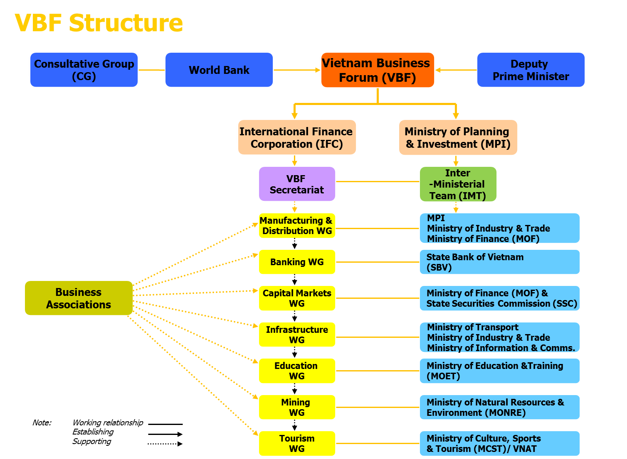
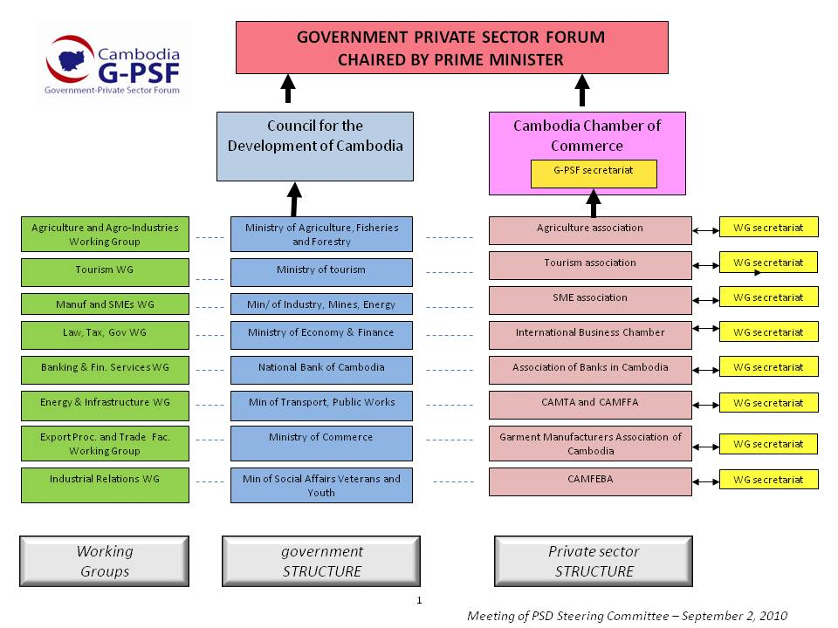
VIETNAM BUSINESS FORUM
CAMBODIA G-PSF
LAO BUSINESS FORUM

Slide 5
HOW DID IFC TRANSITIONED OUT and RESULTS SO FAR
VIETNAM
CAMBODIA G-PSF
LAO BUSINESS FORUM
YEAR OF EXIT
2012 (15 years assistance)
2010 (9 Years)
2010
(3 years)
WHO DOES WHAT ?
Consortium of 14 associations
An MoU signed by
8 associations and the CCI
IFC MoU with LNCCI
OPERATIONAL
SUSTAINABILITY
Gvt secretariat (existing)
1 secretariat at the consortium
9 secretariats
+ Gvt secretariat (existing)
Coordinator funded by IFC
DIALOGUE
EFFECTIVENESS
Regular meetings of the WGs
Regular 2/year VBF
Working Group meetings active
Ad-hoc Plenary Forums
No plenary forum
FINANCIAL
SUSTAINABILITY
Budget support Year 1 – 80K
Consortium: $100,000
Seed funding $10,000 each
Self sustained (operating budget)
Year 1: $80,000 for LNCCI sec.
$15,000/year salary coordinator
RATING
(engage only the presenter)
Fully sustainable
Partially sustainable
No sustainability

Slide 6
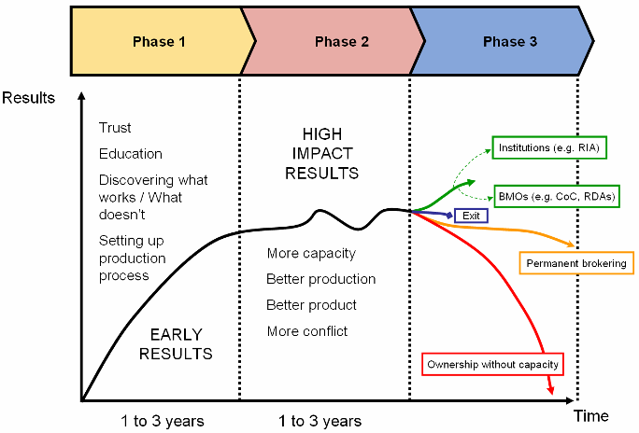
EXIT IN THE PPD LIFECYCLE
PPD Culture
VBF
LBF
GPSF
Herzberg and Levy, 2010

Slide 7
LESSONS
As you enter, think about exit
Prepare, prepare, prepare
Inclusive process
Leadership and commitment
Environment has to be ready: capacity of actors

Slide 8
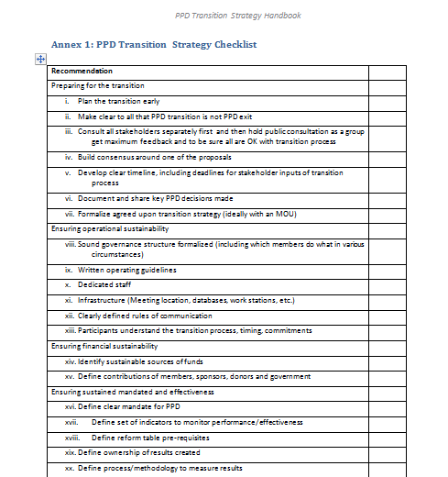
GUIDELINES IN PPD WEBSITE

