Slide 1
International Workshop on Public Private Dialogue
Frankfurt, Germany
2-3 December 2013
The Palestinian Private Sector

Slide 2
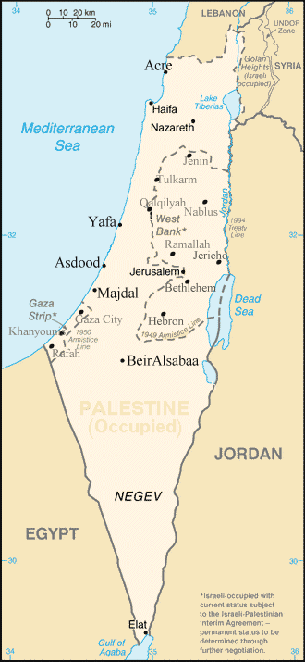
  Palestine
Population (2013): 4,450,500
Market Based Economy
97% of business establishments are small
Real GDP: $6,767
Real GDP Per Capita:$ 1,625
Most geographical areas, borders and natural resources, are controlled by the Israeli Occupation.

Slide 3
The Palestinian Private
Sector…
dri
v
ing for
c
e
behind
Pa
l
es
t
ine's
econom
i
c
gr
o
w
t
is the
h
and
formulates
the
means
by
w
h
ich
to
move
the
Palestinian
e
c
onomy
towa
r
ds
s
u
staina
b
le
development.
Pri
v
a
t
e S
e
c
t
or
Co
n
tribution
t
o
T
o
t
al
P
al
e
s
tinian
GDP
is
72
%

Slide 4
The National Economic Dialogue Conference
Pubic Private Dialogue Started by the establishment of the Palestinian Authority, but officially was structured by 2002 with the first National Economic Dialogue Conference .
Since then 4 national conferences representing Palestinian government and the Palestinian private sector were organized.

Slide 5
Main Goals
Establish and maintain an improved business enabling environment; i.e. policy, legal & regulatory, economic development agenda, special areas of interest including Gaza, Jerusalem and Jordan Valley.
Active participation in formulating national plans and policy agenda; i.e. 3 year social and economic development plan 2014-2016, government budget, economic related laws as well as representation at national economic bodies; i.e. Investment Promotion Agency, Standards Institute, national export council, and others.

Slide 6
Structure
Palestinian PS is highly organized by 10 of national and sector based organizations which created the Palestinian PS Coordinating Council in 2002 to act as an umbrella representation for all organizations.
PPSCC has 2 main goals:
1- Representation of the Private sector with the Palestinian government
2- Coordinating economic development initiatives among the different organizations.

Slide 7
Representation Of PS Agenda
Continuous consultation with all sectors to define the dialogue agenda including SMEs, and different provinces.
White Papers formulations and consensus building.
Formulation of Public and Private Teams for dialogue and conducting actual dialogue among both teams.
National Economic Dialogue Conference headed by PM and Line Minsters.

Slide 8
Challenges
Creating a transparent M&E system to monitor progress and feed in the dialogue process.
Availability of experienced, trained and well informed technical teams of both sides.
Institutionalization of NED

