Slide 1
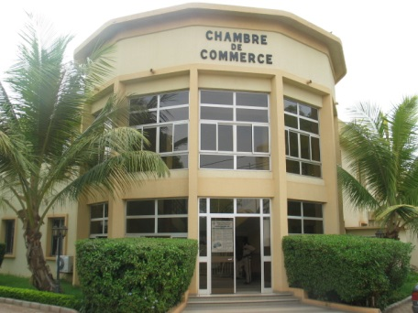
PUBLIC-PRIVATE DIALOGUE :
GOVERNMENT/PRIVATE SECTOR MEETING, BURKINA FASO
Franck TAPSOBA
General Director of the Chamber of Commerce and Industry of Burkina Faso
MARCH 2014

Slide 2

SUMMARY
THE CONTEXT
THE PARTNERS
THE PROCESS
RESULTS OBTAINED
PERSPECTIVES

Slide 3
CONTEXT
Macro-economic Deficits/Burkina PAS (1991)
  Disengagement of the State from the productive sectors.
  Liberalization of business
  Cleaning up the banking system

Slide 4
CONTEXT
  Restructuring the private sector support organisms;
  The creation in 1992 of the « State/private sector Consultation Commission » for participation in the process of restructuring.

Slide 5
CONTEXT
2001 : 1st edition of the Government/private sector meeting (GPSM)
  Framework of the dialogue
  Establishment of a sustainable climate of partnership
2012 : 12th edition (results)
2013 : 13th edition on « The importance of the informal work sector: strategies for their integration into the formal economy »

Slide 6
THE PARTNERS
Public administration
Private sector
Technical and financial partners
Civil society

Slide 7
THE PROCESS
THE ORGANIZATIONAL COMMITTEE: COMPOSITION
  Prime Minister
  Minister of Industry and Commerce
  Minister of the Economy and Finance
  Chamber of Commerce and Industry
  Maison de l’Entreprise

Slide 8
THE PROCESS
THE ORGANIZATIONAL COMMITTEE: ITS PURPOSE
  Proposing subjects
  Preparation forg sectoral meetings
  Identification of participants
  Preparation for the annual meeting
  Write-up of reports of this meeting

Slide 9
THE PROCESS
SECTORAL MEETINGS
SECTORAL DIALOGUE FRAMEWORK
  Interested ministries
  Professional groups in the sector
  Support institutions
  PTF

Slide 10
THE PROCESS
  SECTORAL MEETINGS
  Eleven (11) sectors of activity
  Construction and public works
  Telecommunications, communication, information technology and communication;
  Transportation
  Social sectors (health, education, etc.)
  Justice/labor/employment ;

Slide 11
THE PROCESS
  SECTORAL MEETINGS
  Commerce ;
  Industry, energy and mining ;
  Agriculture, livestock and environmental resources;
  Banking and insurance;
  Artisanship/art/ tourism/Artisanat/art/tourisme/hotel industry;
  Security (surveillance and guards, transfer of money, detective services, etc.)

Slide 12
THE PROCESS
THE ANNUAL MEETING
  Unresolved sectoral preoccupations
  Problems across sectors
  Presided over by the Prime Minister
  Announcement of measures taken or recommendations

Slide 13
PROCESS
MONITORING SYSTEM
The Joint Technical Committee (JTC)
  Evaluate the level of completion of the measures taken (trimester meeting).
    Representatives from the State and private sector, presided over by the General Secretary of the Ministry in charge of promoting business.

Slide 14
PROCESS
Monitoring System
The Oversight Committee
  Examines the difficulties in implementing the measures taken.
    Ministers in charge of business, finance, and labor;
    President of the Chamber of Commerce and Industry;
    President of the professional and industrial groups.

Slide 15
PROCES
Monitoring System
The Secretariat of the CTP
  Operated by the General Direction of the promotion of business.

Slide 16
PROCESSUS
MONITORING SYSTEM
Focal points
  Follow-up on the implementation of decisions / ministries
    Representatives of the ministries involved.

Slide 17
RESULTS OBTAINED
The simplification of procedures for the payment of taxes
The reform of public markets
The creation and devolution of the CEFORE
The creation of Business Courts
The creation of a Center of Arbitration, Mediation, and Conciliation

Slide 18
RESULTS OBTAINED
Revision of the Mining Code
Revision of the Labor Code
Improvement of the business climate. « Doing business better in Burkina Faso »
Editing of the Code of Investment
…

Slide 19
PERSPECTIVES
Some major unresolved issues:
  Reduction in the cost of factors of production
  The fight against fraud and counterfeiting
  Access to financing by the SME
  Reforme of the conditions for creating businesses: minimum capital required

Slide 20
CONCLUSION
The major challenge for us is a better structuring of the dialogue at the early stages.

Slide 21

I thank you for your attention.

