Slide 1


Sustainable PPD in a Volatile Political Environment
The Egyptian Experience
Marwan El Sammak
Alexandria Business Association

Slide 2
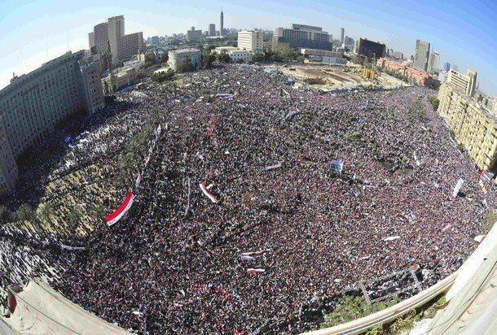
Egypt… A Country in Transition
Egypt
Political
Social
Economic

Slide 3
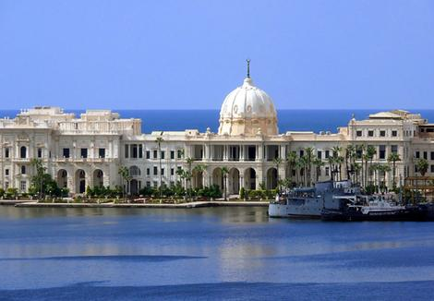
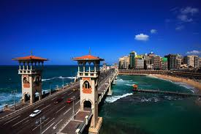
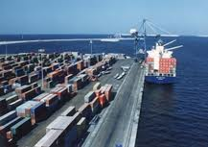
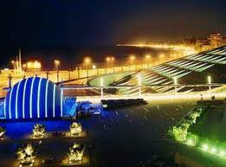
The Alexandria Business Association was registered in March 1988 as a non-profit, non-government organization.
Alexandria Business Association (ABA) began its activities providing support to the private sector; promoting the interests of the business community; providing networking opportunities; consolidating business and social ties and advocating the views of the members to the government.

Slide 4
Member Services
Community Development
Advocacy
Business sectors
Microfinance Project
Evidence Based Advocacy (Islah, MRI)
National Dialogue
Subnational Dialogue
Community Service Activities
Philanthropic Activities
Cross Sectoral Services
Development Programs
18 Committees
ABA Activities

Slide 5
Demand Driven Advocacy
Establishing ABA Advocacy Unit
2008
Islah Reform Index - Issue I
2009
Microenterprise Reform Index - Issue I
2013
Islah Reform Index – Issue II
2012
Position Papers 2011
Decentralization - Administrative Development Access to Finance
Problem Solving
Issue Based Approach
Demand Driven Advocacy Needs
Collaboration with IFC

Slide 6

Advocacy Reform in Collaboration with
Initial engagement: Collaboration with IFC, to set up a private Sector Observatory, to monitor Business Startup Streamlining project in Alexandria.
Project Design: Project evolved into a full fledged Evidence Based Advocacy Project, establishing a Private Sector Observatory within ABA.
Progress Over Time: Establishing an Advocacy Unit, housing a National Private Sector Led Dialogue Platform.

Slide 7

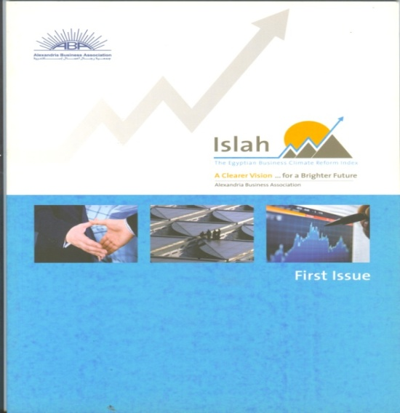
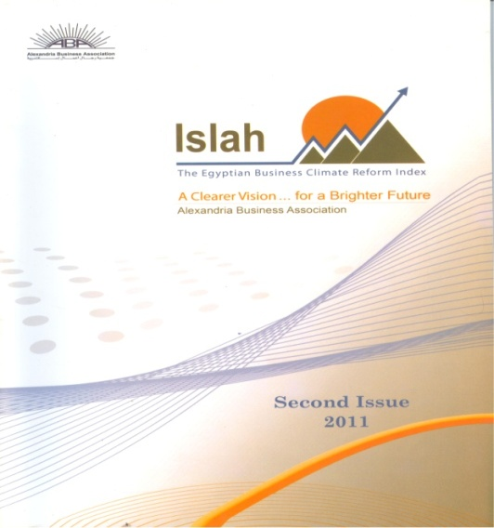
Local to National Dialogue Using Islah Reform Index
The Index was designed based on the World Bank Doing Business Policy Areas, from a local perspective.
Created to regularly measure and monitor the progress of government reforms as perceived by the business community.
Contributing to improving business practices in Egypt through continuously illustrating and communicating the business climate performance, challenges, and potential.
Creating a clearer perception and understanding of the nature and practices of business reform in Egypt.
It is an Index to be used for a public - private dialogue, to identify and address the agenda of reform.

Slide 8
Islah Reform Index
ABA Partners:
    IFC
    GAFI
    Alexandria University
    EBA
    CCFE
    Cairo University
ISLAH I
ISLAH II
Policy Areas Covered:
1-Starting a Business 2-Dealing with Licenses
3-Registering Property 4-Employing Workers
5-Dealing with Banks 6-Protecting Investors
7-Paying Taxes 8-Trading Across Borders
9-Enforcing Contracts 10-Exiting a Business
11-Infrastructure and Logistics

Slide 9
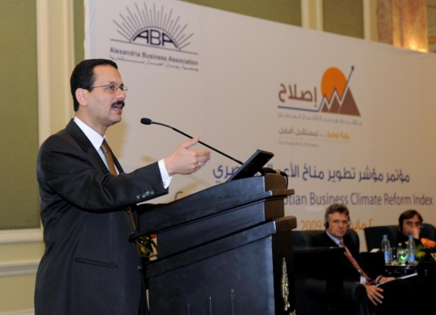
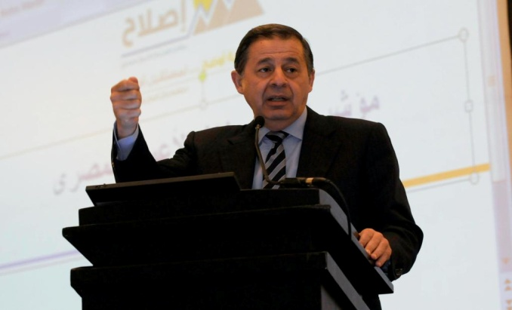
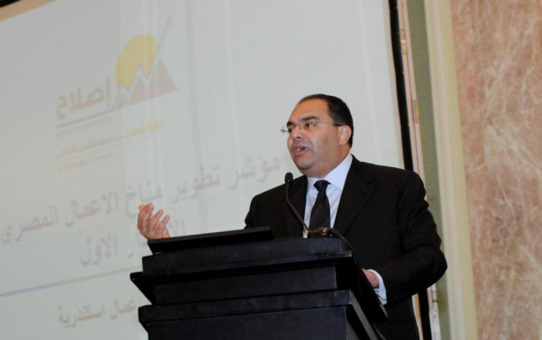
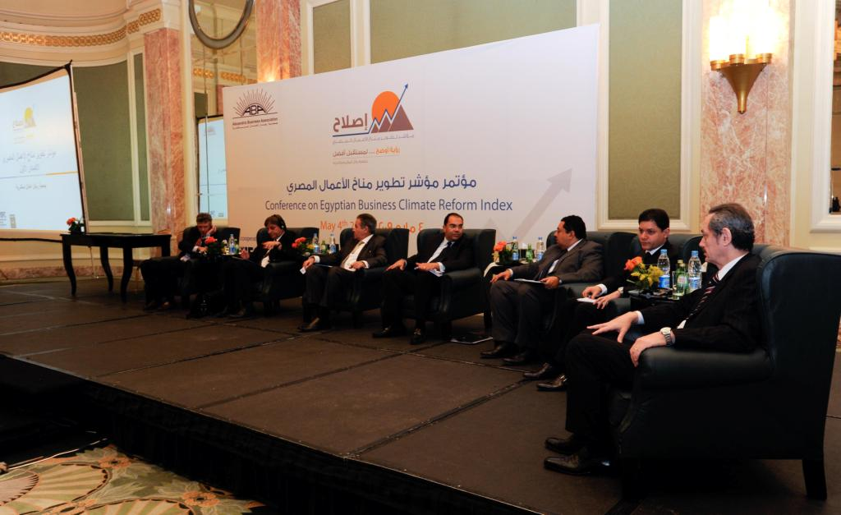
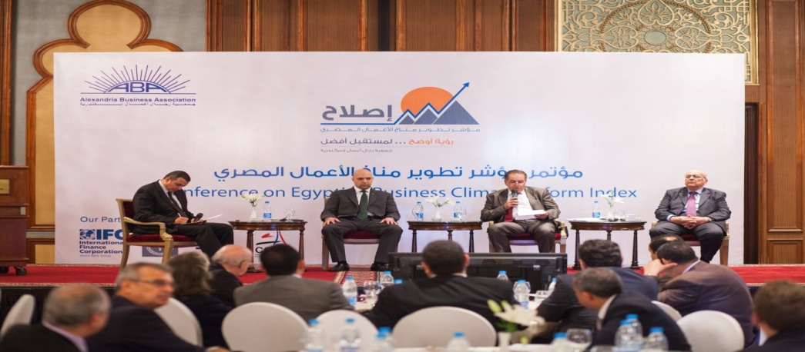
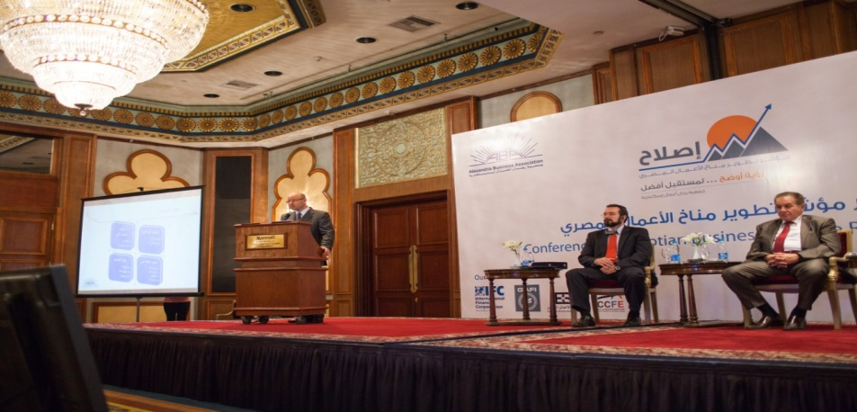
Islah Launch Events

Slide 10
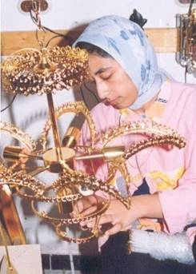
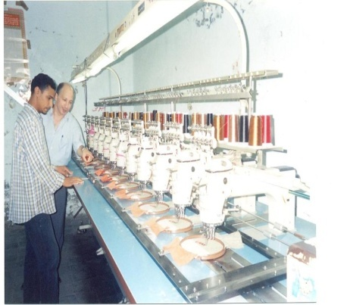
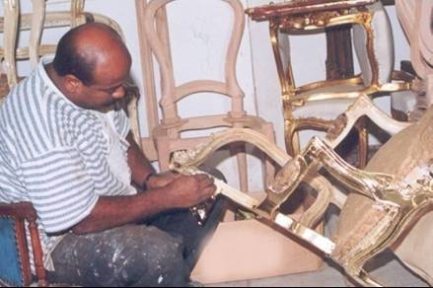
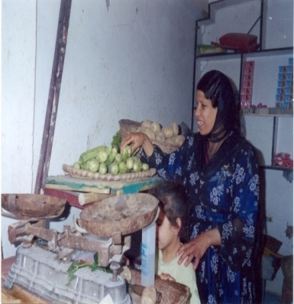
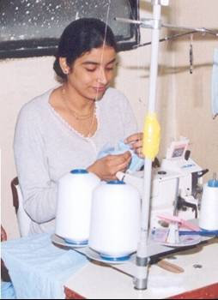
Small and Micro Enterprise Project
ABA is considered one of the leading NGOs in the field of promoting small and micro enterprises, addressing financial inclusion.
ABA started a comprehensive credit program in January 1990.
The program is internationally recognized and received several awards as one of the world's best practices in Micro Finance due to the diversification of its credit programs and the innovative use of tools to achieve its objectives.

Slide 11
Small and Micro Enterprise Project To date
Total Amount lent | EGP 4,898,237 - $ 1,760,798
Total No. of Loans - (Jan 2014) | 2,179,737
Average Loan Size | L.E. 2,130 - $ 304,4
Amount Lent - (Jan 2014) | EGP 440,373,000 - $ 63,822,186
No. of Borrowers | 796,847
Women Borrowers | 55%
Repayment Rate | 98.54%
Staff Members | 1197
Branches | 60 Branches over 6 Governorates

Slide 12


National Level PPD Using Microenterprise Reform Index
Helping diagnose and address MSME problems that may lead to converting them from the informal to formal economy.
Creating a useful tool to help the government identify development areas and creating incentives to encourage small business owners to grow their business.
Giving a voice to MSMEs that face challenges for sustainability in current turbulent economic times due to marginalization and poor resources.

Slide 13
Microenterprise Reform Index
Governorates Covered | Business Sector | Sample Size
Alexandria Algharbya Monofya Elbeheira Kafr Elshiekh | Manufacturing, Services Trade Micro industries | 601
ABA Partners:
    IFC
    Ministry of Trade and Industry

Slide 14
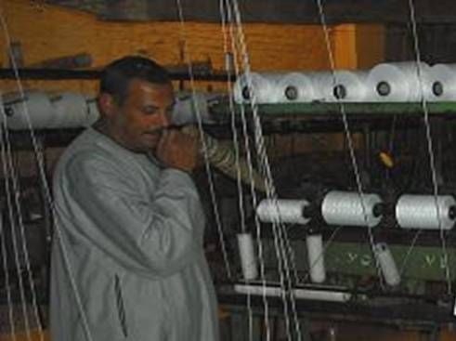
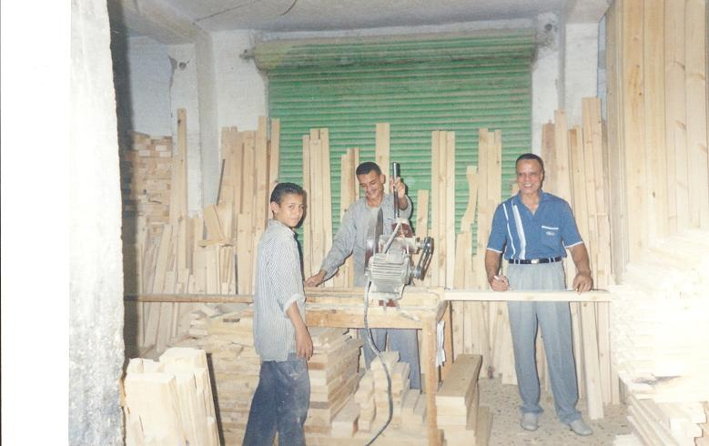
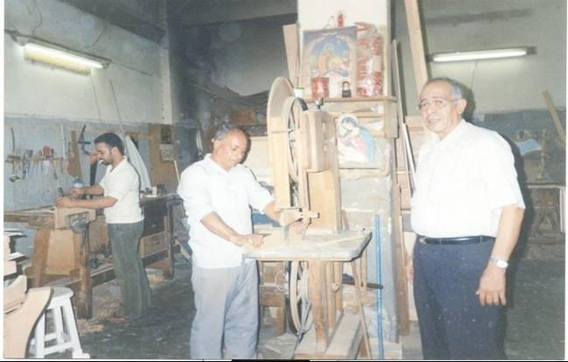
Measuring Competitiveness: MRI Components
MRI is based on WEF Competitiveness Report
1. Institutional Environment
How laws and regulations affect business productivity as well as their influence on firms choosing to be part of the formal or
informal sector.
2. Market Efficiency
An overview of the consumer goods, finance and labor market effect on MSME operations.
3. Business Sophistication
Level of professionalism in MSME management, marketing, planning, market information utilization and competitive advantage.

Slide 15
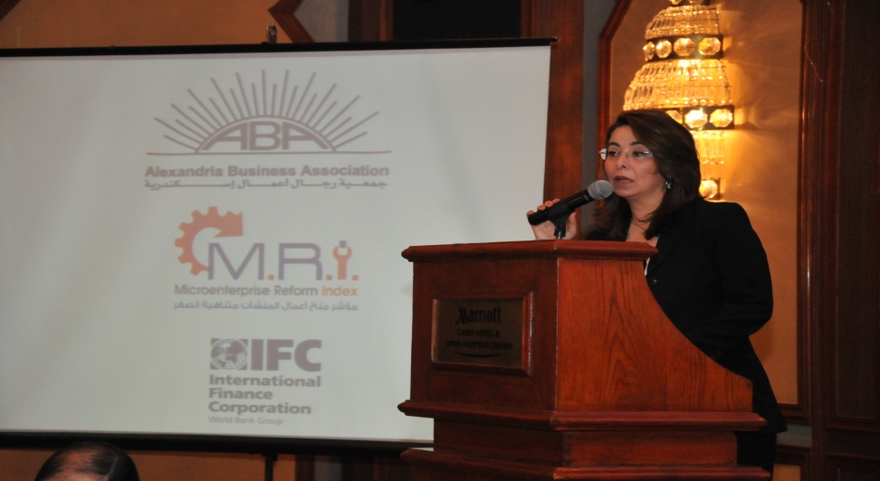
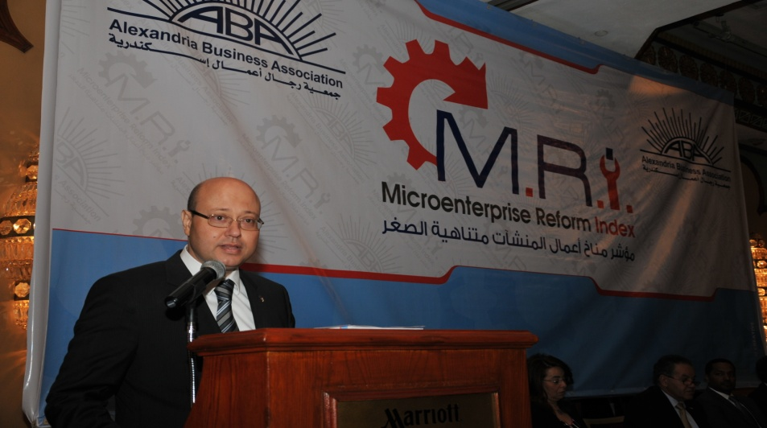
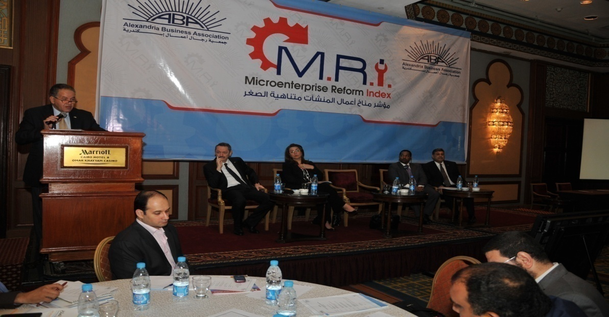
MRI Launch Event

Slide 16
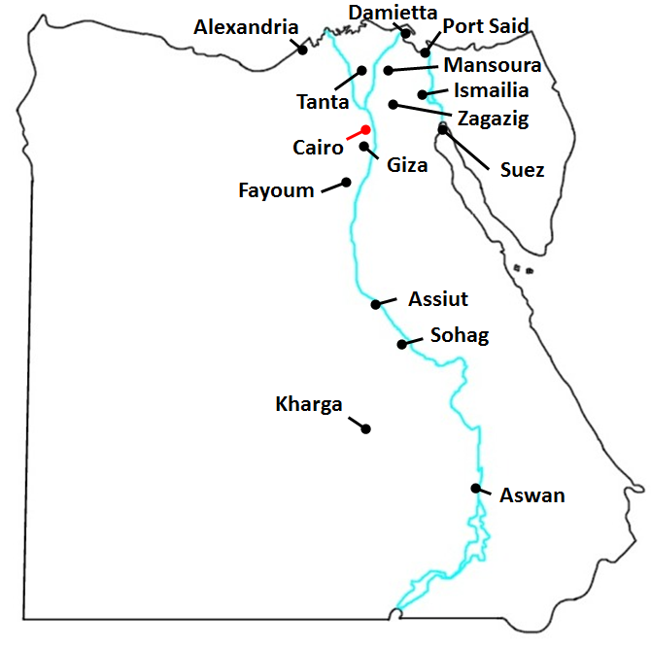
Egypt Doing Business Report 2014
SNDB Egypt project was in response to a request by GoE, led by the Ministry of Investment and Ministry of Local Development
15 cities were carefully selected according to Subnational DB standards and in order to ensure that urban centers, port, touristic and frontier cities are represented, to allow for replication.
4 indicators (starting a business, dealing with construction permits, registering property and enforcing contracts) were measured in the 15 cities.
Trading across borders indicator was measured in 5 strategic ports.

Slide 17
Sub National PPD Using Egypt Doing Business 2014
Egypt’s performance in Doing Business 2014 (Global Rank) | Egyptian best practices compared internationally (Global Rank) | Doing Business Indicator
149 | 39 | Dealing with Construction Permits
105 | 56 | Registering Property
156 | 103 | Enforcing Contracts
128 | 104 | Ease of Doing Business

Slide 18
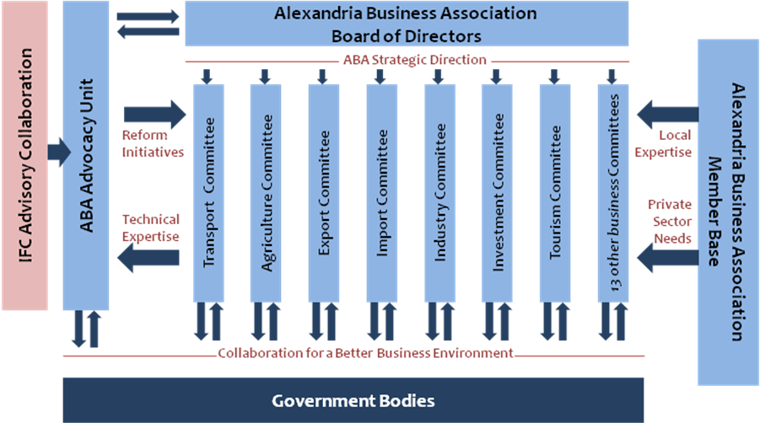
Sustainable Private Sector Led PPD
Local Level PPD - Using Islah I
National Level PPD – Using Islah II / MRI
Sub National PPD – Using Egypt DB 2014
Partner Associations Member Base

Slide 19
Sustaining PPD in Egypt
National Level PPD
Invite in coming government to set up a structured national PPD, with identified reform agenda.
Expand network of alliance to include more business associations in other governorates
Plan the issue of Islah III and MRI II
Ensure voice of private sector and MSMEs is unified and represented in front of government counterparts.
Potential automation of survey for wider coverage
Local Level PPD
Utilize Egypt DB 2014 results to develop a reform agenda for Alexandria
Establish and sustain a Dialogue with Alexandria Governorate and other private sector partners, to implement reform agenda.
Capitalize on established Alexandria Business Council, headed by ABA, to monitor government commitment and reform process.

Slide 20

THANK YOU

