Slide 1

Partnerships for Prosperity (P4P)
An overview
PPD Workshop, March 2014

Slide 2
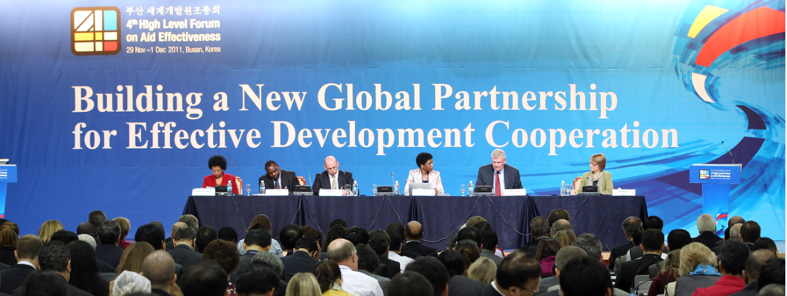
Busan – a new world of development
Diversity of actors and forms of co-operation
Complementarity with other resources for development
Catalytic role of co-operation
Unique value and nature of South-South co-operation
Additional agreements launched in Busan:
The Joint Statement on Expanding and Enhancing Public and Private Co-operation for Broad-Based, Inclusive and Sustainable Growth

Slide 3
The Busan Partnership agreement
Shared principles to achieve common goals
  Ownership of development priorities by developing countries
  Focus on results
  Inclusive development partnerships
  Transparency and accountability to each other
Reaffirming commitments for effective aid (Paris and Accra)
Shift from aid effectiveness to effective development co-operation
Recognizing the central role of the private sector in advancing innovation, creating wealth, income and jobs, mobilizing domestic resources and in turn contributing to poverty reduction

Slide 4
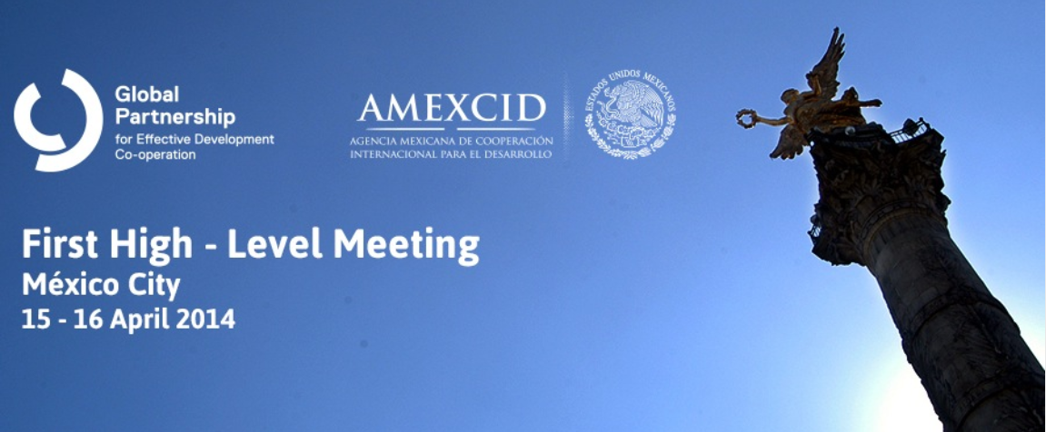
1st HLM of the Global Partnership
  An opportunity to:
  Reaffirm Paris/Accra/Busan principles
  Assess and showcase progress and challenges
  Reiterate confidence in the Global Partnership as the most innovative and inclusive platform of its kind
  Test our willingness to work together with others and lead by example

Slide 5
From Private Sector Building Block to P4P
P4P is a multi-stakeholder platform to convene knowledge, innovative ideas and initiatives, as well as strategic partnerships on the role of the private sector in contributing to sustainable development
In Busan, representatives of developing and developed countries, private sector entities and corporations, heads of multilateral and bilateral institutions, and regional organizations recognized the necessity "to engage the private sector as an equal partner in pursuing a fundamentally different way of doing development.“
Busan participants endorsed the principles of the Global Partnership for Effective Development Cooperation
Private Sector Building Block was created in the run up to the 4th High-Level Forum for Aid Effectiveness, specifically to facilitate a space for the creation of development partnerships
In October 2013: Private Sector Building Block re-branding to Partnerships for Prosperity (P4P)
P4P is taking the lead in post-Busan private sector engagement, focusing on
  Innovation
  Convening Capacity
P4P Secretariat is hosted by IFC in Paris and managed by Albena Melin

Slide 6
P4P – Mission and Goals
“Expanding and enhancing public and private co-operation for broad-based, inclusive and sustainable growth”
Focus on problem-solving through scalable programs in partnerships rather than pure information sharing
High-level dialogue, organized around sectors or specific transactions, concrete activities and international policy issues
Strengthen MNCs ability to measure their development impact
Increase understanding of business practices from the development side
Create clear links between business leaders and development partners to (i) reduce risk and (ii) create stronger shareholder relationships
Enhance risk-sharing instruments that public agencies can deploy; promote early-stage capital for developing new markets (especially BoP markets) and catalytic finance
Deliver concrete outcomes by focusing on the country level and tangible issues

Slide 7
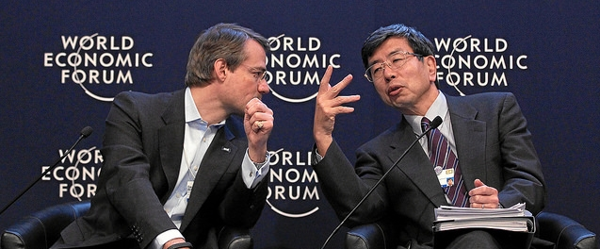
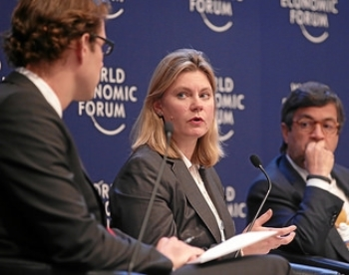
P4P – Some examples
P4P, jointly with WEF, the DAC Chair’s Office and DFID, designed two sessions at this year’s World Economic Forum Annual Meeting in Davos
1. New Models of Development Finance
2. Breaking Silos in Development
P4P at the second Meeting of the Swedish Leadership for Sustainable Development.
The meeting with 20 Swedish CEOs (from companies such as Ericsson, H&M, Scania and Volvo), took stock of concrete partnerships with the private sector (on education and job creation, sustainable supply chains, sustainability reporting, etc.), and of how Sida works with companies to provide leadership on sustainable development along its Post-2015 agenda.
Preparations for Global Partnership High-Level Meeting in Mexico City
The Mexico HLM will be crucial in setting the stage for identifying practical ways to implement sustainable development goals. The Plenary Theme focuses on breaking down silos and building more effective partnerships between governments, businesses and civil society. The following themes are currently under discussion for additional Focus Sessions:
Innovations in development finance
The private sector in fragile states
Transparency, anti-corruption and business in the post 2015 framework
Proving prosperity in public-private sector cooperation
P4P at Seoul workshop on strategies and best practices for effective development cooperation
Sharing experiences and challenges in implementing the Global Partnership
principles

