Slide 1
Public-Private Dialogue Hub
Anna Nadgrodkiewicz
Director, Multiregional Programs, CIPE
Frankfurt, Germany
March 5, 2014

Slide 2


Public-Private Dialogue (PPD) Hub
Interactive space for the global PPD community of practice
  Provide best practices and learning opportunities
  Exchange PPD experiences from around the world
2.0 version of www.publicprivatedialogue.org
Multi-stakeholder effort led by CIPE and WBI
Notes:
Part of the broader WBI Open Private Sector initiative

Slide 3
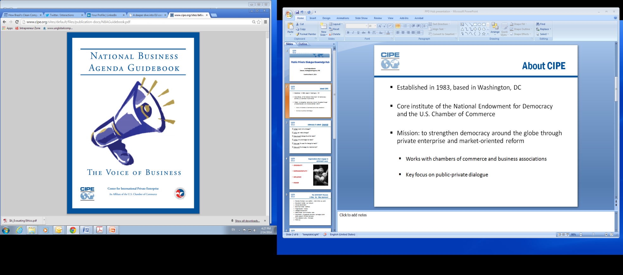
About CIPE
Mission: to strengthen democracy around the globe through private enterprise and market-oriented reform
Core institute of the National Endowment for Democracy and a U.S. Chamber of Commerce affiliate
  Established in 1983, 1,300+ projects in over 100 countries
  Works with chambers of commerce, associations, economic think tanks
  Key focus on public-private dialogue
  Long-standing cooperation with WBI

Slide 4
PPD Hub Objectives & Audience
Goal: To improve governance & business environment by promoting inclusive and sustainable growth at the country and sector level through public-private dialogue
  Support a global community of practice
  Accelerate the uptake of best practices
Audience: Business orgs, governments, donors
  There are 300 million companies in the world, most absent from PPD in their countries
  Governments need private sector in shaping policies
  Donors need to share PPD approaches that show results

Slide 5



How will the PPD Hub work?
Content created by the community of practice
  Country cases
  Tools
  Lessons learned
  eLearning
Moderated by CIPE and WBI
Updates on news and events
Social media networks
www.facebook.com/publicprivatedialogue
#PPD

Slide 6
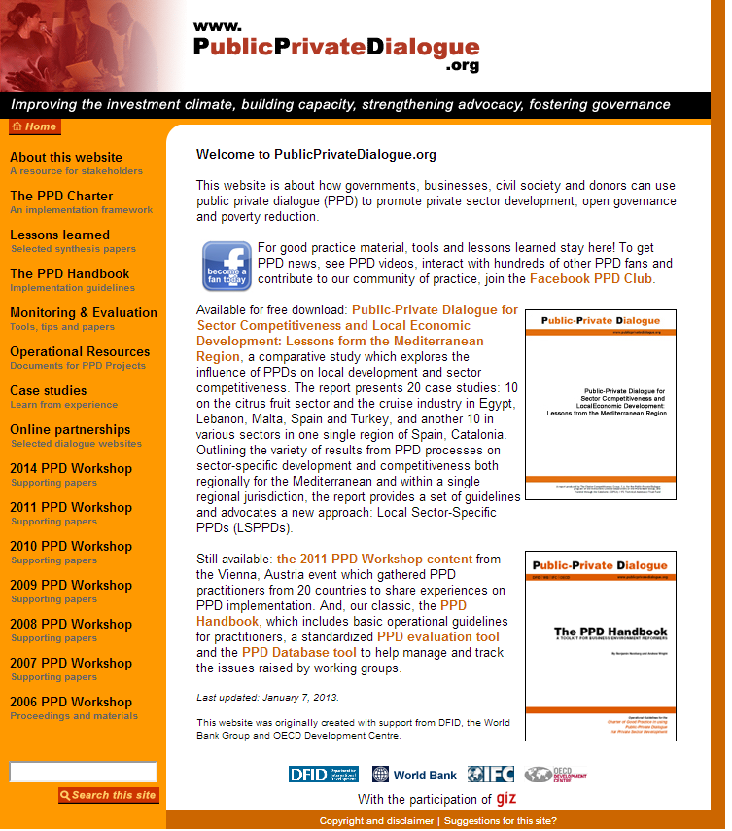
Current PPD Website
Great resource though…
  Largely static
  Lacks interactive element
  Difficult to find info
  Social media not fully integrated with

Slide 7

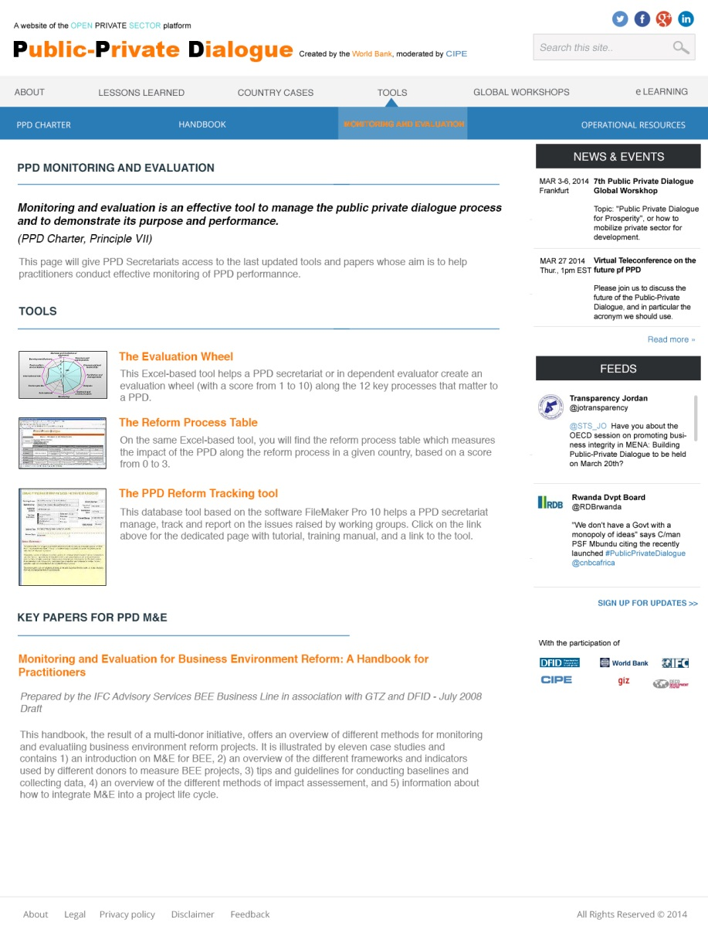
New PPD Hub Preview

Slide 8

Q&A: We want your feedback!
What is the best way to grow and sustain the global community of practice on PPD?
What types of PPD resources do you use and how do you use them?
How can the new PPD Hub best assist in your work? What features would you like to see there?
What e-communication channels would you prefer to learn, share, and stay in touch?
Do you see yourself as an active participant?
Notes:
These questions will be distributed in hard copy on the tables and also form the basis for Q&A

Slide 9
Thank you for your attention!
Contact information
Anna Nadgrodkiewicz
Director, Multiregional Programs, CIPE
anadgrodkiewicz@cipe.org
Benjamin Herzberg
Program Lead, Private Sector Engagement for Good Governance (PSGG), World Bank Institute
bherzberg@worldbank.org

